Slide 1
Use iceman in new Corvette F1-AE250
Driving Innovations™
OS Team
Jim
2018-7-16

Slide 2
new Corvette F1-AE250
new Corvette F1-AE250
Only plug 1 usb on the UART port (CON2).
UART and ICE both use the UART port currently.
Install libusbk to support ICE.
Run iceman by “./ICEman -Z v5”, no need of “-I olimex-arm-usb-tiny-h.cfg”
Notes:
2

Slide 3
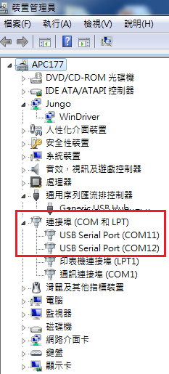
Installing libusbK
Before installing libusbK, we have 2 COM ports of Corvette-F1
Notes:
3

Slide 4
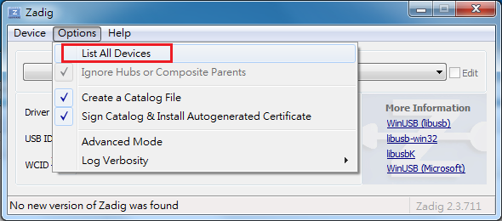
Installing libusbK
0. Download Zadig and run it.
T:\users\ghij\JimShu\share\zadig_20171002_win7
1. List all devices
Notes:
4

Slide 5
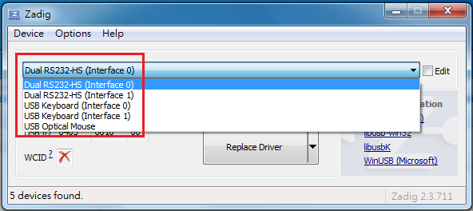
Installing libusbK
2. Choose “Dual RS232-HS (Interface 0)”
Notes:
5

Slide 6
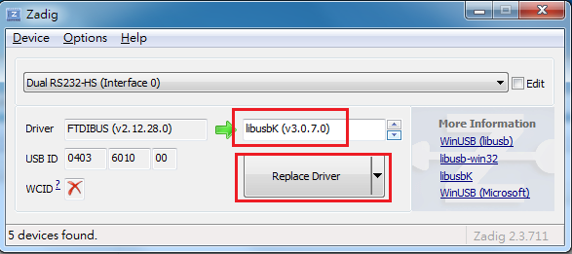
Installing libusbK
3. Choose Driver “libusbK”
4. Press “Replace Driver” to install libusbK driver.
Notes:
6

Slide 7
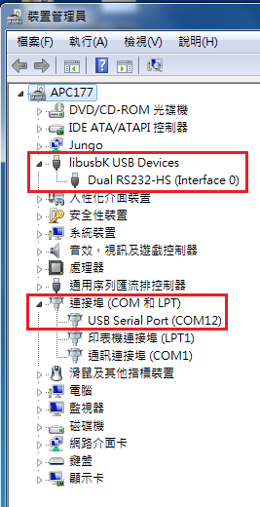
Installing libusbK
After installing libusbK, we have 1 COM port and 1 libusbK USB Device of Corvette-F1
We can use ICEman now!
Notes:
7

Slide 8

Thank You!
www.andestech.com

